Slide 1
Library News & Updates

Slide 2
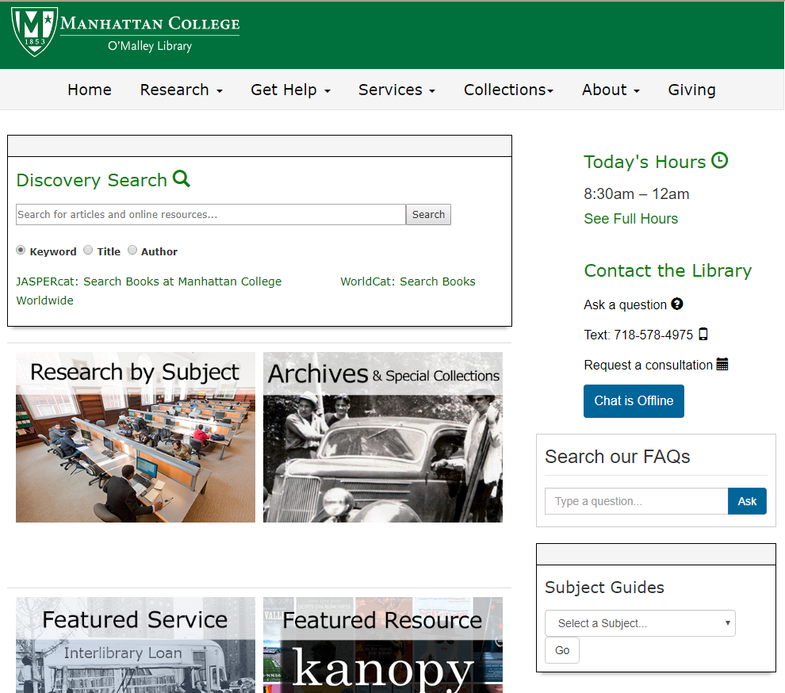
New Web Site
http://lib.manhattan.edu

Slide 3
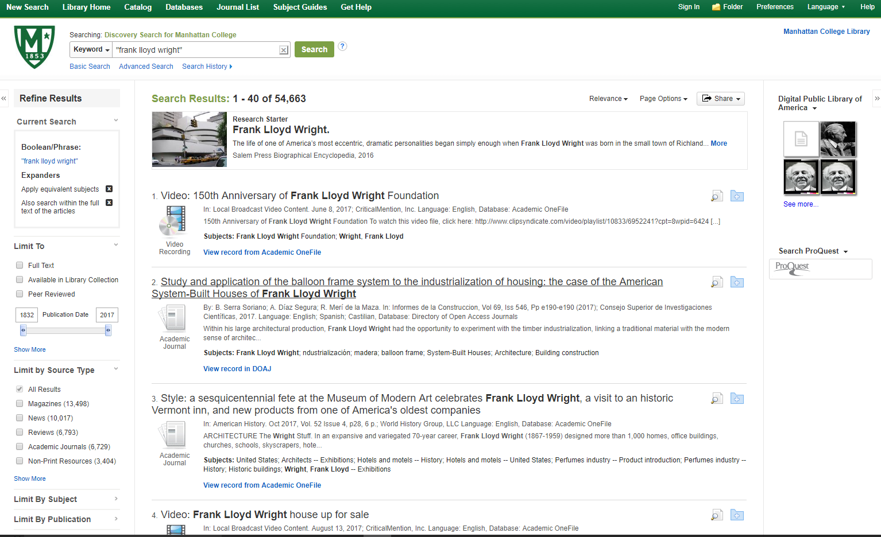
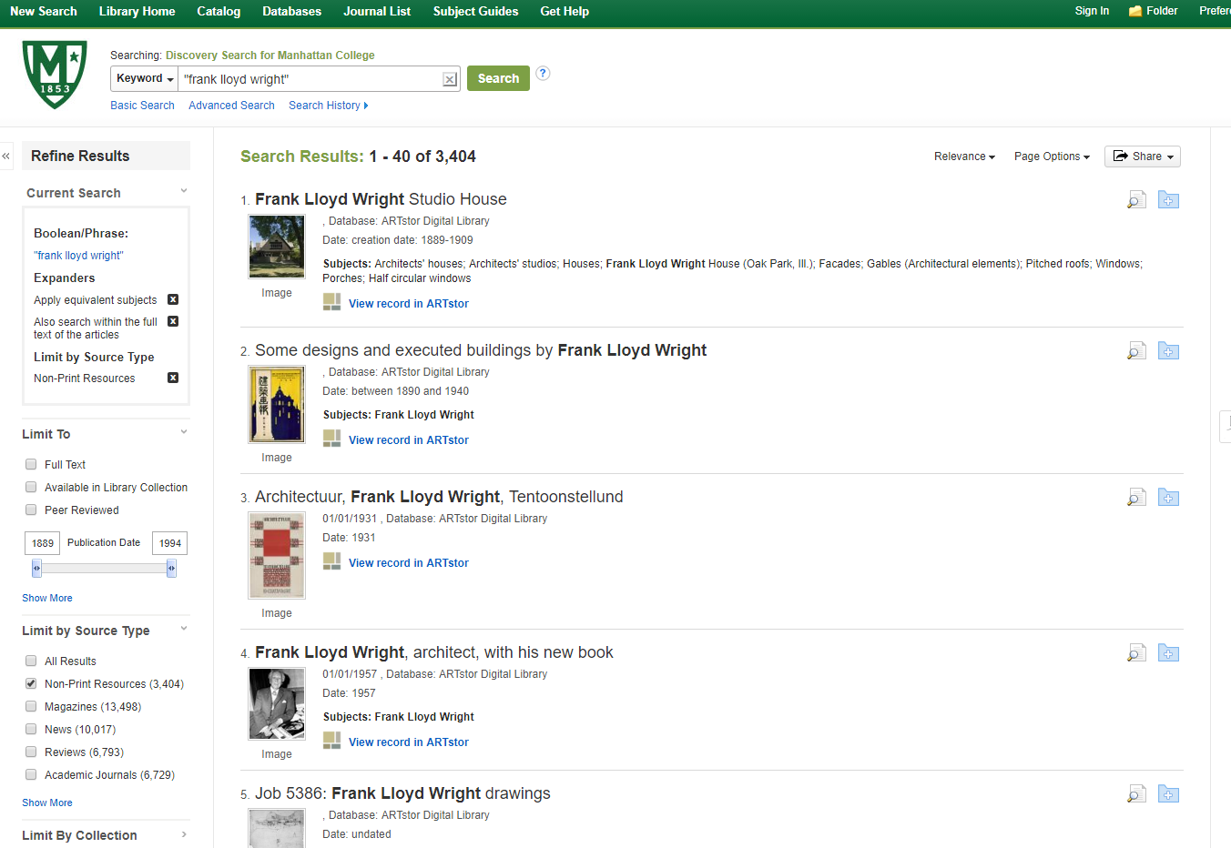
New Discovery Search Tool
EBSCO Discovery Service (EDS) is an online research tool that “pulls together” almost all of our Library resources so that they can be explored using a single search box.

Slide 4

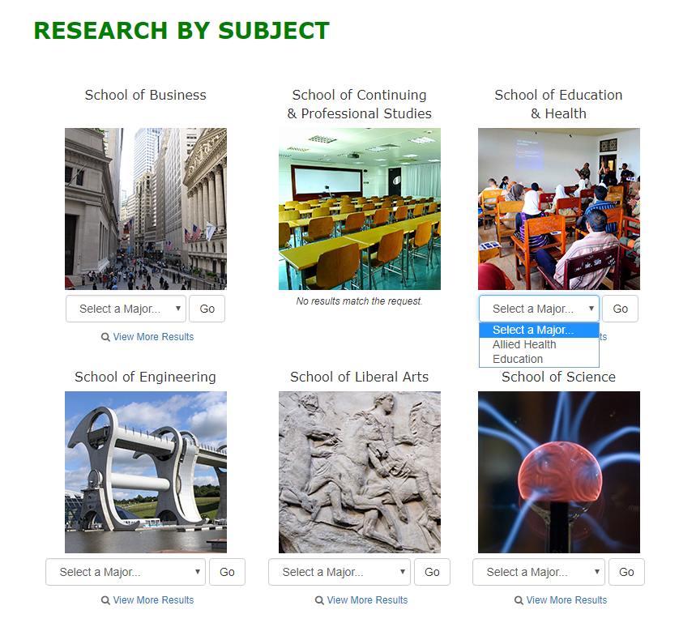
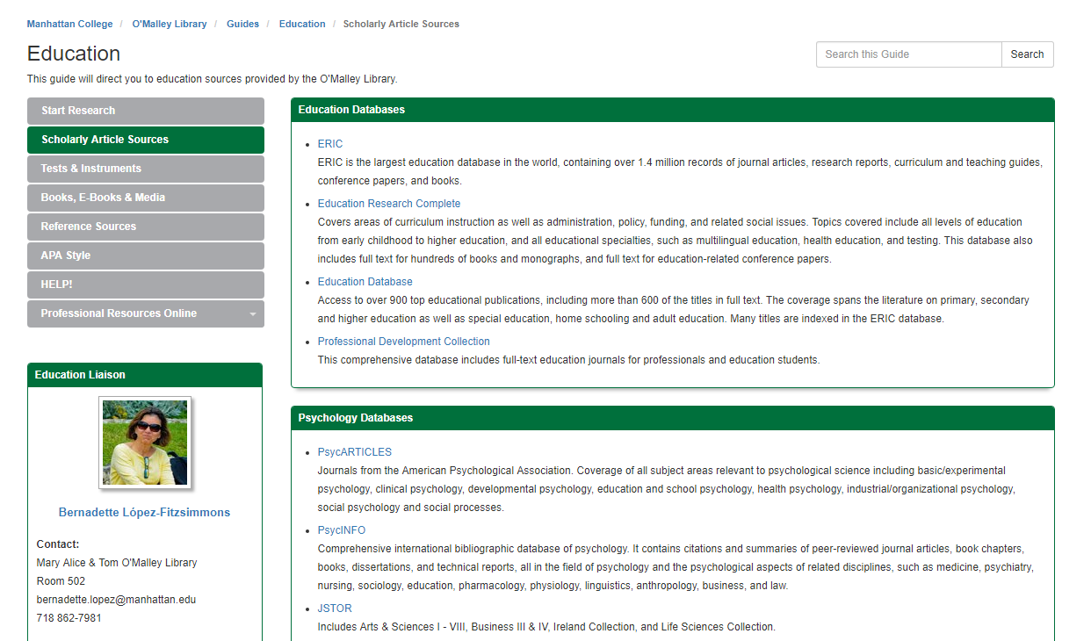
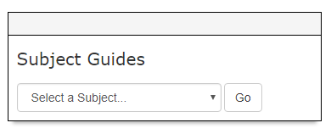
Research by Subject

Slide 5
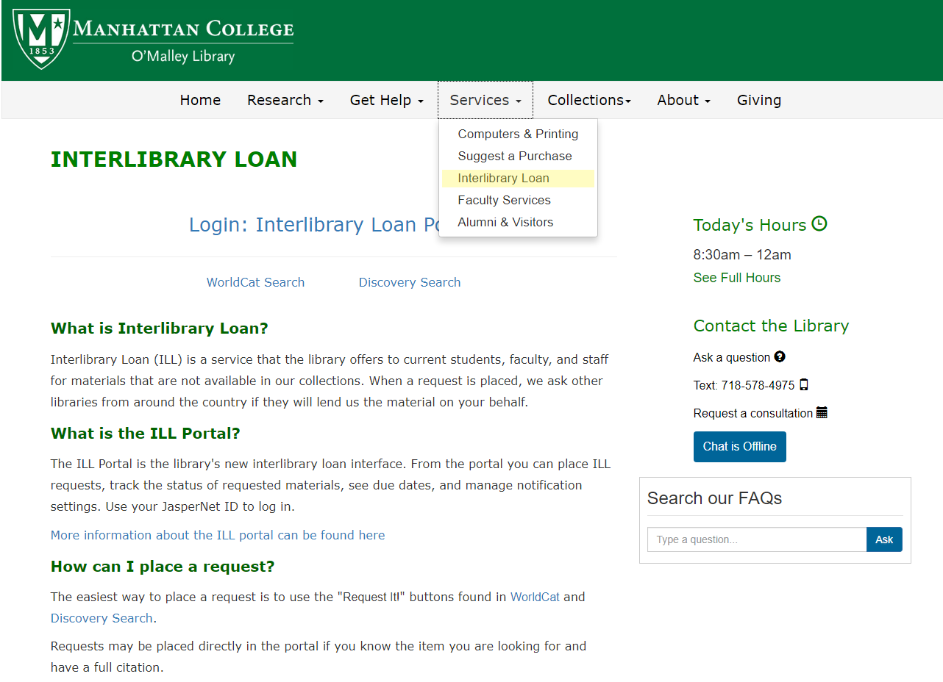
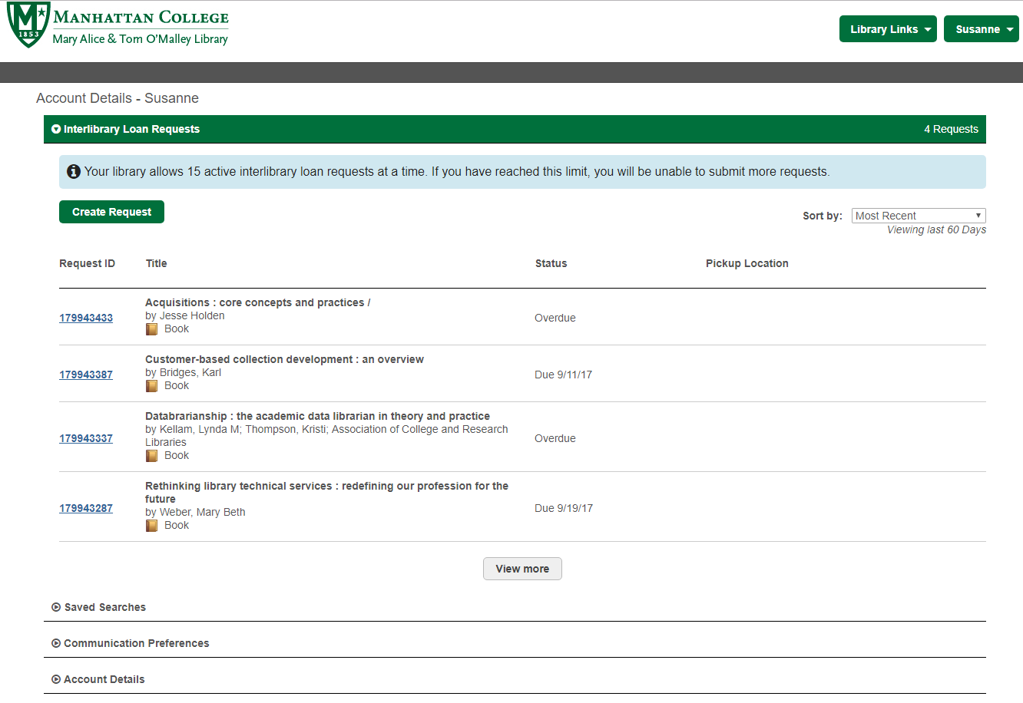
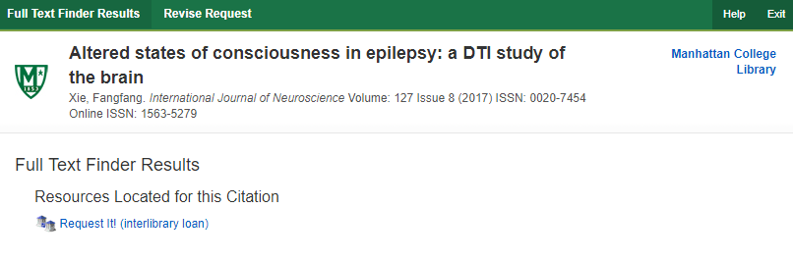
New Interlibrary Loan Portal
If the database does not have the full text, click on the “Find Full Text” button. If no other (subscribed) databases have the full text, use the Request It! link to submit an interlibrary loan request.

Slide 6
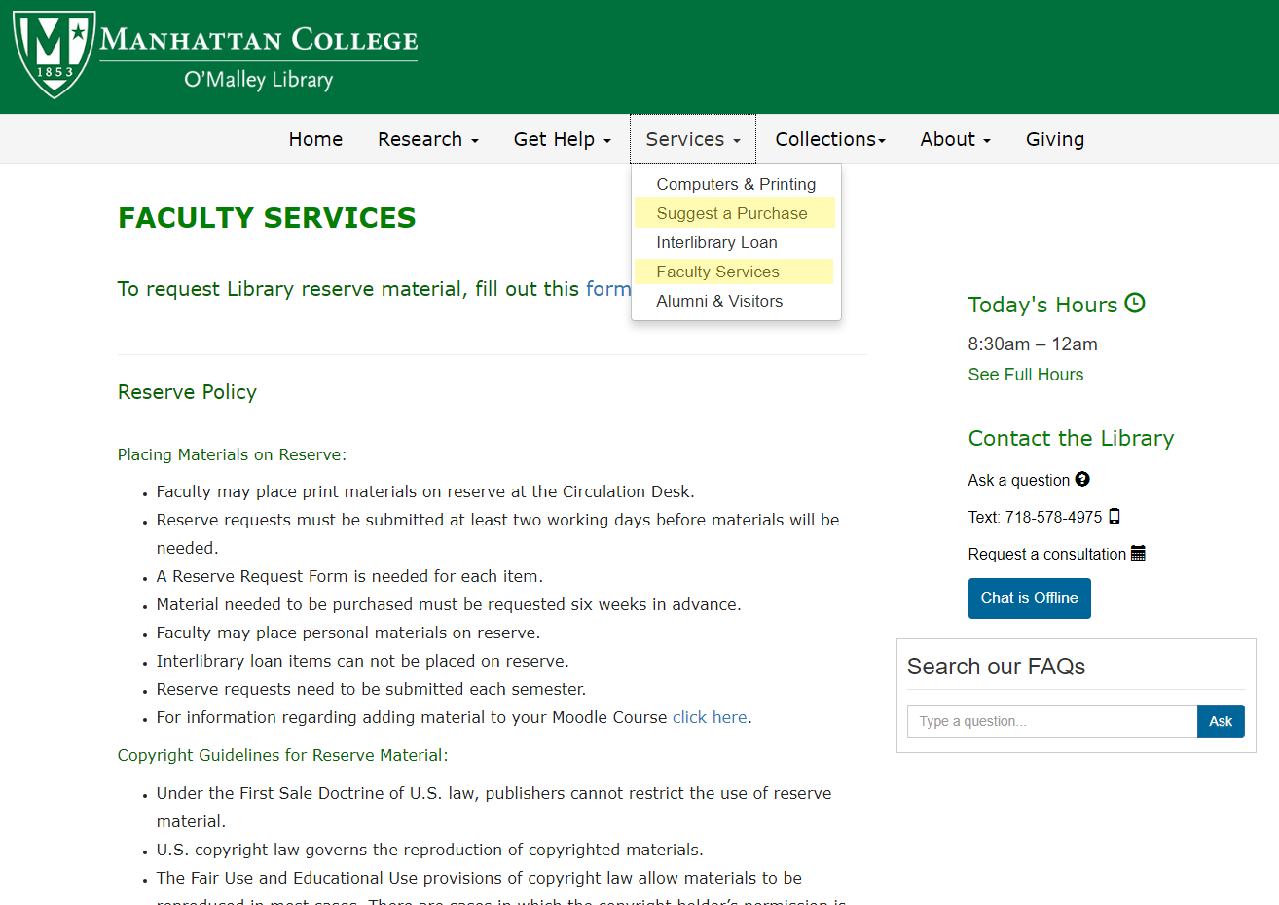
New Request Forms

Slide 7
New Databases
AccessEngineering
An engineering reference tool for professionals, academics, and students that provides seamless access to the world's best-known, most-used collection of authoritative, regularly updated engineering reference information.
Kanopy
A video streaming solution for colleges offering a “Netflix-like” user experience and a broad selection of documentaries, feature films, foreign language films and training videos from thousands of producers.
Slavery in America and the World: History, Culture, & Law
Brings together a multitude of essential legal materials on slavery in the United States and the English-speaking world. This includes every statute passed by every colony and state on slavery, every federal statute dealing with slavery, and all reported state and federal cases on slavery.
Testing & Education Resource Center
Contains over 300 practice tests and courses for high school, college, graduate school, and international students.

Slide 8
NYPL Visit - Access to additional resources
African American Experience
American Indian Experience
The American Israelite
Chinese Newspapers Collection
Historic Newspapers (Boston Globe, Christian Science Monitor, Globe & Mail, Irish Times, Los Angeles Times, New York Herald, and many more... )
Dead Sea Scrolls Electronic Library
Eighteenth Century Collections Online (ECCO)
Ethnic News Watch
___________________________________________________________________
Freegal Music A downloadable music service which provides access to the catalog of artists in Sony Music Entertainment. Library cardholders can download three songs a week.
Lynda.com Includes over 5,700 courses (and over 180,000 videos) in fields like web design, web development, IT, education/instruction, media production, and business.
Mango Languages Learn a new language with this interactive database that provides step by step lesson plans for 71 different languages.
https://www.nypl.org/collections
Mark your calendars! NYPL’s visit: Tuesday, September 12, 11am - 2pm
Get a New York Public Library card to access more resources: https://www.nypl.org/library-card

Slide 9
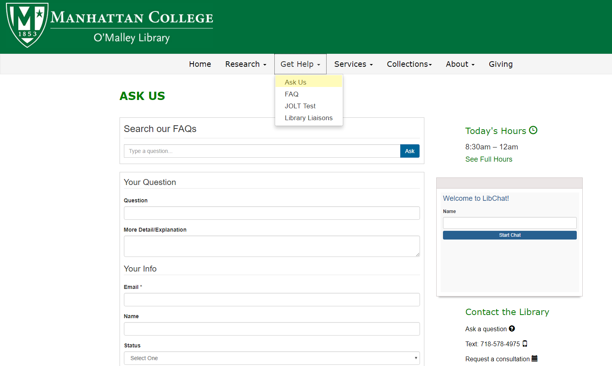
Contact Us!

Slide 10
Library Liaison Program
Librarians assigned to different departments based on their subject specialties.
Liaison Librarian acts as the point person for a particular department’s reference and instruction needs.
Liaison Librarian works with faculty to built the library’s collection with specific subject areas.

