Slide 1
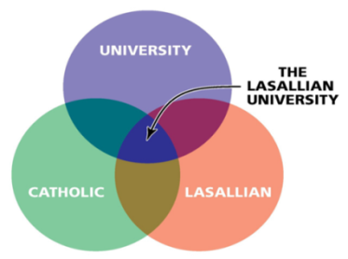
Manhattan College Senate
Mission
Strategic Plan
Core Identity
(Special Sauce)
Brother Jack Curran ‘80, FSC, PhD
Vice President for Mission
Tuesday, November 15, 2016
Kelly Commons

Slide 2
Prayer
God, grant us the serenity to accept the people we cannot change,
which is pretty much everyone, since we’re clearly not you, God.
At least not the last time we checked.
And while you’re at it, God, please give us the courage to change what we need to change about ourselves,
which is frankly a lot, since, once again, we’re not you, which means we’re not perfect.
It’s better for us to focus on changing ourselves than to worry about changing other people, who, as you’ll no doubt remember us saying, we can’t change anyway.
Finally, give us the wisdom to just shut up whenever we think that we’re clearly smarter
than everyone else in the room,
that no one knows what they’re talking about except us,
or that we alone have all the answers.
Basically, God, grant us the wisdom to remember that we’re not you.
Amen
Adapted from James Martin, SJ
https://thejesuitpost.org/2012/11/a-new-serenity-prayer/

Slide 3
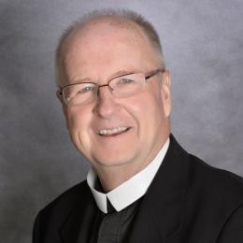
Vice President for Mission
Assist the Manhattan College community in their efforts
to realize, promote, and integrate
the distinctive academic and societal mission of the College and
its Lasallian Catholic identity.

Slide 4

Mission
Strategic Plan
Core Identity
(Special Sauce)

Slide 5
Mission & Strategic Planning Trustee Committee
Dr. Shawn Ladda, Faculty Affairs Representative
Dean Salwa Ammar, Administrative Representative
Mr. Joseph (Joey) Moussa, Student Representative
Mr. Ronald (Ron) Contreras, Student Representative
Mary Ellen LaMonica, Staff Representative
Dr. Peter McCarthy, Senate Representative
John (Jack) McMaster, Trustee
Kenneth Orce, Trustee, Committee Chair
Margaret Walsh, Trustee
Kenneth Rathgeber, Trustee, Board Chair, Ex-Officio
Dr. Brennan O'Donnell, Ex-Officio
Dr. David Mahan, Guest
Brother Jack Curran, FSC, Cabinet Representative

Slide 6

Mission
The mission of Manhattan College is to provide a contemporary, person-centered educational experience that prepares graduates for lives of personal development, professional success, civic engagement, and service to their fellow human beings… through programs that integrate a broad liberal education with concentration in specific disciplines in the arts and sciences or with professional preparation in business, education and engineering.

Slide 7
Strategic Plan

Slide 8

Lasallian Catholic Core Identity

Slide 9
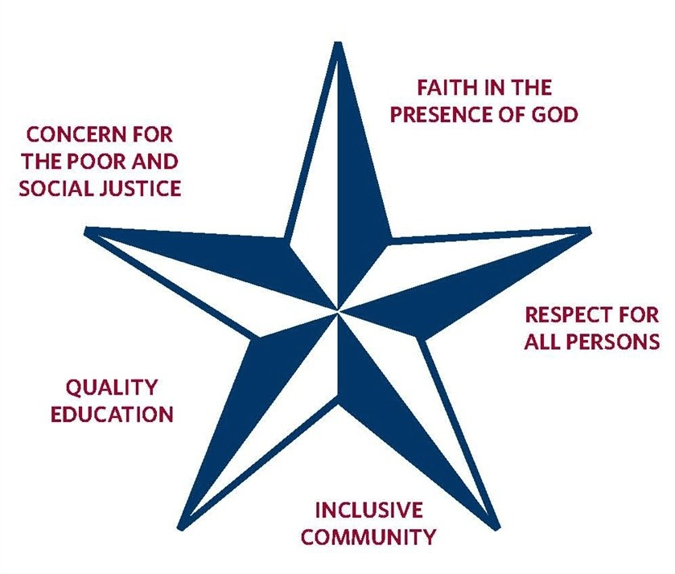
Lasallian Core Principles

Slide 10
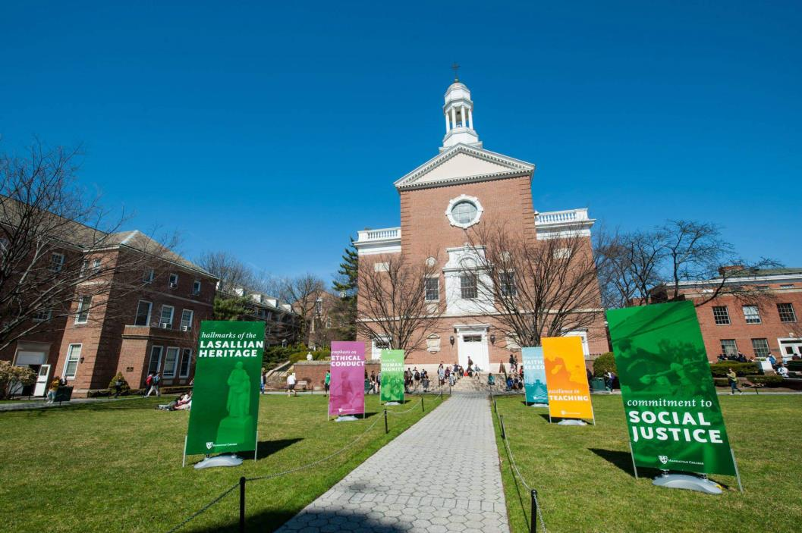
Lasallian Hallmarks

Slide 11
Lasallian Catholic Core Identity
Core Principles
Quality education
Respect for all people
Faith in the presence of God
Inclusive Community
Concern for the poor and social justice
Hallmarks
Excellence in teaching
Respect for human dignity
Reflection on Faith and its relation to reason
Emphasis on ethical conduct
Commitment to Social Justice

Slide 12
Lasallian Catholic Core Identity
Catholic Intellectual Tradition
Continuity of faith and reason
Cumulative aspect of wisdom
A non-elitist bent
We are a community
Knowledge and wisdom are to be used
The sacramental principle
Ref: Lasallian Centers of Higher Education bulletin 252, p. 33-35
Catholic Social Doctrine
Human dignity
Community
Opting for the poor
Rights and responsibilities
Role of government and subsidiarity
Economic justice
We are servants who look after creation
We promote peace and disarmament
Participation and inclusion
Global solidarity and development

Slide 13

Lasallian Catholic Core Identity

Slide 14
Mission and Strategic Planning
Committee Charter Operationalized
(Bylaws)
Assist the Board in
overseeing the strategic planning process of the College by
identifying strategic issues and planning assumptions
monitoring adherence to Mission and Strategic Plan
formulating ensuing cycles and long range plans
reporting to the Board on the status of the College’s Strategic Plan and its adherence to Mission.

Slide 15
Committee Agenda
(Committee Charter)
Review Dashboard
  Admissions, Enrollment, Discount Rate
  Faculty Diversity, Student-Faculty Ratio
  Retention and Graduation Rate
  Finance
  Advancement
  Marketing and Communications
  Student Engagement and Satisfaction (NSSE / GSS)
Review
  Internal and External Assumptions
  Institutional Effectiveness Reports
  Special Reports (e.g., Middle States)
  Report Strategic Plan Progress
  Lasallian Catholic Mission Activities

Slide 16
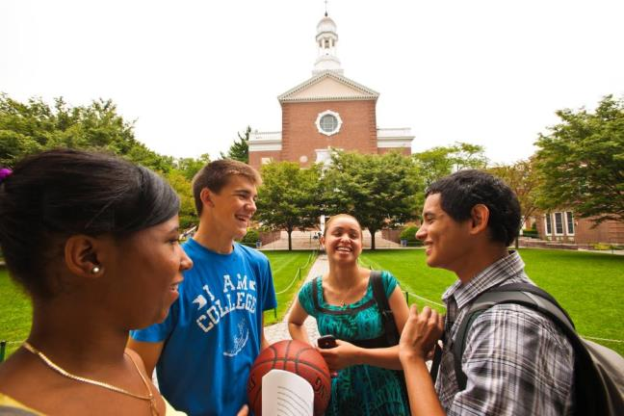
Manhattan College Strategic Plan
DENA Directional Statements & Action Items
Alignments and Intersections
Provost Group
Dean Salwa Ammar, Brother Jack Curran, Lois Harr (January 13, 2016)
Mission and Strategic Planning Trustee Committee
Dean Salwa Ammar, Brother Jack Curran, Dr. David Mahan (October 13, 2016)
Monitoring adherence to Mission and Strategic Plan

Slide 17
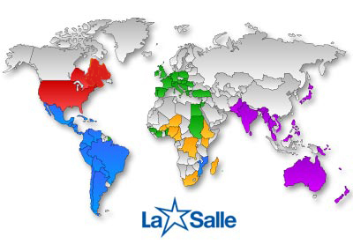
The International Lasallian Network (Institute)
Primary, Secondary, Higher, Community-Based
1,000,000 Students 85,000 Faculty, Staff, Administrators
80 Countries 4,500 Brothers
Regions
**RELAN: Anglo America
RELEM: Europe
RELAL: Latin America
RELAF: Africa
PARC: Asia
Districts / Provinces
**District of Eastern North America (DENA)
Midwest District
District of San Francisco New Orleans
Francaphone Canada District

Slide 18
The International Lasallian Network (Institute)
Primary, Secondary, Higher, Community-Based
Lasallian Institute
to provide
a human and Christian education, especially
for the poor
Manhattan College
to provide
a contemporary, person-centered educational experience that prepares graduates for lives of personal development, professional success, civic engagement, and service to their fellow human beings.

Slide 19
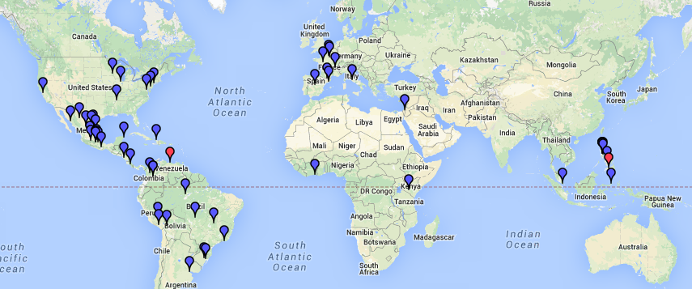
The International Lasallian Network:
60 IALU Higher Education (Manhattan College, established in 1853, is the first of 60)
Europe Latin America Africa North America Asia/Oceana
7 34 1 7* 11

Slide 20

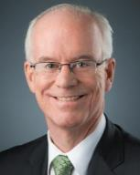
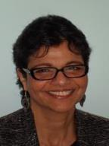
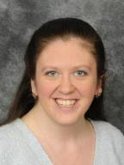
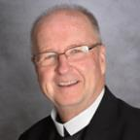
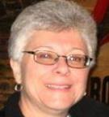
DENA Mission Assembly (March 12-14, 2015)
To set the direction for mission for the coming 3-4 years
Manhattan College DENA Delegation
Evangelization and Catechesis
        Ms. Lois Harr, Director of Campus Ministry and Social Action
Service with the Poor through Education
    Dr. Gwendolyn Tedeschi, Associate Professor of Economics and Coordinator of Community Based Learning
Living the Charism in Association for Mission
    Dr. Brennan O’Donnell, President
    Brother Jack Curran, FSC, PhD, Vice President for Mission
    Dr. Salwa Ammar, Dean, School of Business

Slide 21

DENA Directional Statements Approved by the Mission Assembly March 14, 2015
FSC District Chapter August 13, 2015
Evangelization and Catechesis There is an urgency today to “set on fire” the Lasallian Catholic evangelical mission within each of our educational communities to do as Jesus did by joyfully announcing the radical Good News that God loves us all and calls us to cooperate in building God’s Kingdom. | B. Service with the Poor through Education The ministries and stakeholders of DENA, faithful to the Lasallian mission and values of service of and with the poor, will, together and by association, deliver sustainable models for education and treatment and advocate for those we accompany and support, especially the poor, that they “may have life and have it in its fullest.” (John 10:10) | Living the Charism in Association for Mission In order to foster and enrich our Lasallian charism, we recognize the need to invite and encourage all members of Lasallian communities to associate for mission. We aim to ensure that each local ministry is supported by, and in turn, supports district, regional and international formation initiatives.
As Lasallian Catholic Communities we must engage young people in a process of coming to know the mystery and purpose of their lives. For all young people we will offer opportunities for faith formation and development so that they will seek to discover and develop a personal relationship with God in the context of a faith community. For those who are Catholic the educational community will offer opportunities to grow in the fullness of their Catholic faith. | Each ministry will gather information, both quantitatively and qualitatively, regarding the current engagement of and with the poor in their ministry, in particular through current enrollment of students and service programs. The ministry will use this data to set realistic goals within their community to continue to increase their engagement of and with the poor. These goals will be included in their Lasallian Mission Assessment Process or Strategic Planning process and will be reviewed on the annual mission visits. | The District of Eastern North America will utilize 21st century learning modalities and current technology to develop accessible, innovative, engaging, and relevant formation programs for Lasallians, accessing expertise from throughout the Region and Institute.
Both Boards and Administrators will ensure that funding for religious education and campus ministry will be of primary importance. They also will establish funding for service and immersion opportunities for students that give rise to critical reflection in the light of faith. In addition, they will support the development of retreats for Boards, staff, students, and families that reflect the current realities of the ministries in their implementation of the Lasallian Catholic Mission. | To create meaningful exchanges across ministries, DENA and Chief Administrators will encourage the formation of twinning and other collaborative efforts among DENA ministries. In support of these exchanges, DENA will facilitate the creation of a database to encourage collaboration and cooperation among our ministries that will encourage the creation of partnerships, learning opportunities and other activities in service with the poor. | The District will put special emphasis on providing opportunities to enrich the Lasallian charism by fostering interreligious understanding and dialogue; and, participation by those of all faith traditions in the mission.
Honoring our current international commitments to the Lwanga District in Africa, St. Vincent Strambi in Jamaica, Bethlehem University in the Holy Land, and the College of St. John Baptist de La Salle in Haiti, we will continue to cultivate the mutual cultural and evangelical opportunities these relationships present. In addition we will remain open to the call of the Institute to the sensitivity of migratory movements. | To continue to safeguard the rights of our children and the young, we ensure a culture of nonviolence that educates for and cultivates peacemaking, advocacy and respect for the God given dignity of human persons and God’s creation. | The chief administrator commits to developing and implementing ongoing structured programing, which utilizes Lasallians who have participated in formation and/or other Lasallian resources.

Slide 22


Alignments and Intersections
Are we (MC & DENA) on the same page?
Do our Manhattan College goals and plans align with those of DENA?
MC Strategic Plan Phase 2
Approved by the
Trustees June 2015
DENA Directional Statements Approved by the
Mission Assembly Mar 2015
FSC District Chapter Aug 2015

Slide 24
DENA Directional Statements Approved by the District Chapter August 13, 2015
A. Evangelization and Catechesis There is an urgency today to “set on fire” the Lasallian Catholic evangelical mission within each of our educational communities to do as Jesus did by joyfully announcing the radical Good News that God loves us all and calls us to cooperate in building God’s Kingdom. 1.2 3.2 | B. Service with the Poor through Education The ministries and stakeholders of DENA, faithful to the Lasallian mission and values of service of and with the poor, will, together and by association, deliver sustainable models for education and treatment and advocate for those we accompany and support, especially the poor, that they “may have life and have it in its fullest.” (John 10:10) 1.3.1 2.5 2.5.1 | C. Living the Charism in Association for Mission In order to foster and enrich our Lasallian charism, we recognize the need to invite and encourage all members of Lasallian communities to associate for mission. We aim to ensure that each local ministry is supported by, and in turn, supports district, regional and international formation initiatives. 2.5 2.5.2
As Lasallian Catholic Communities we must engage young people in a process of coming to know the mystery and purpose of their lives. For all young people we will offer opportunities for faith formation and development so that they will seek to discover and develop a personal relationship with God in the context of a faith community. For those who are Catholic the educational community will offer opportunities to grow in the fullness of their Catholic faith. 1.2.2 2.2 2.2.2 2.3 | Each ministry will gather information, both quantitatively and qualitatively, regarding the current engagement of and with the poor in their ministry, in particular through current enrollment of students and service programs. The ministry will use this data to set realistic goals within their community to continue to increase their engagement of and with the poor. These goals will be included in their Lasallian Mission Assessment Process or Strategic Planning process and will be reviewed on the annual mission visits. 2.1.1 2.2.3 2.5.1 | The District of Eastern North America will utilize 21st century learning modalities and current technology to develop accessible, innovative, engaging, and relevant formation programs for Lasallians, accessing expertise from throughout the Region and Institute. 1.1.1 2.5.2
Both Boards and Administrators will ensure that funding for religious education and campus ministry will be of primary importance. They also will establish funding for service and immersion opportunities for students that give rise to critical reflection in the light of faith. In addition, they will support the development of retreats for Boards, staff, students, and families that reflect the current realities of the ministries in their implementation of the Lasallian Catholic Mission. 2.3.1 2.3.2 3.2.2 3.4.4 | To create meaningful exchanges across ministries, DENA and Chief Administrators will encourage the formation of twinning and other collaborative efforts among DENA ministries. In support of these exchanges, DENA will facilitate the creation of a database to encourage collaboration and cooperation among our ministries that will encourage the creation of partnerships, learning opportunities and other activities in service with the poor. 3.4.4 | The District will put special emphasis on providing opportunities to enrich the Lasallian charism by fostering interreligious understanding and dialogue; and, participation by those of all faith traditions in the mission. 1.2.2 3.2.2
Honoring our current international commitments to the Lwanga District in Africa, St. Vincent Strambi in Jamaica, Bethlehem University in the Holy Land, and the College of St. John Baptist de La Salle in Haiti, we will continue to cultivate the mutual cultural and evangelical opportunities these relationships present. In addition we will remain open to the call of the Institute to the sensitivity of migratory movements. 2.3.2 3.2.2 3.4.4 | To continue to safeguard the rights of our children and the young, we ensure a culture of nonviolence that educates for and cultivates peacemaking, advocacy and respect for the God given dignity of human persons and God’s creation. 1.3.1 2.2 2.2.1 | The chief administrator commits to developing and implementing ongoing structured programing, which utilizes Lasallians who have participated in formation and/or other Lasallian resources. 1.1.1 2.5.2

Slide 25
An Example of Intersection and Alignment
Manhattan College Strategic Plan
2.5 Ensure financial resources and administrative capacity to recruit and retain excellent students, faculty, staff, administrators, and trustees.
2.5.1 Ensure effective outreach to and affordability of education for excellent students, especially first-generation students and those from a diverse range of backgrounds.
DENA Directional Statement (B.1.) Service with the Poor through Education
The ministries and stakeholders of DENA, faithful to the Lasallian mission and values of service of and with the poor, will, together and by association, deliver sustainable models for education and treatment and advocate for those we accompany and support, especially the poor, that they “may have life and have it in its fullest.” (John 10:10)

Slide 26
An Example of Intersection and Alignment
Manhattan College Strategic Plan 1.3.1
Encourage and support collaborative research, scholarship, and service as a means of enhancing teaching, and in particular, that which is aligned with the International Lasallian Research agenda**
  DENA Directional Statement (B.3) Service with the Poor through Education
  To continue to safeguard the rights of our children and the young, we ensure a culture of nonviolence that educates for and cultivates peacemaking, advocacy and respect for the God given dignity of human persons and God’s creation.
** Lasallian Research Agenda
https://inside.manhattan.edu/academic-resources/research/lasallian-research-scholars.php
Food, Nutrition, and Health
Sustainability and the Environment
Education and Learning Innovations
The Life and Heritage of St John Baptist De La Salle
The Plight of Immigrants, Displaced Persons, & Children in Disadvantaged Circumstances

Slide 27
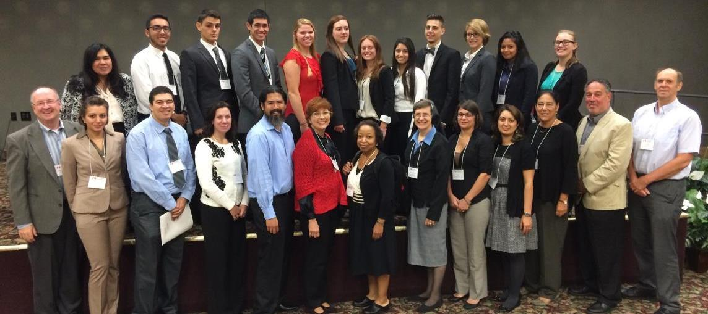
International Symposium on Lasallian Research @ Saint Mary’s University of MN
Food, Nutrition and Health
Sustainability and the Environment
Education, Learning Innovations, and Evangelization
The life and heritage of John Baptist de La Salle
September 2014: 8 Faculty
September 2015: 12 Faculty and 13 Students
September 2016: 15 Faculty and 8 Students
Notes:
This is another opportunity for professional development – networking with colleagues from other Lasallian colleges and universities – and presenting research findings.

Slide 28
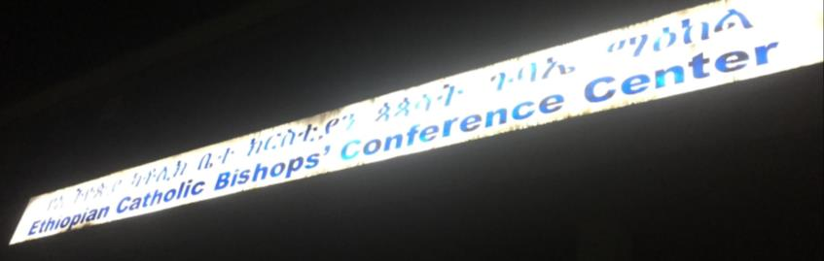
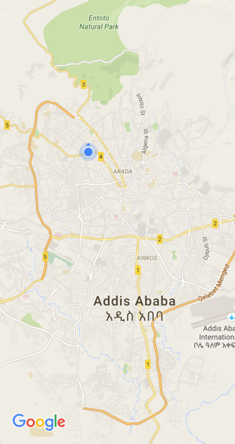
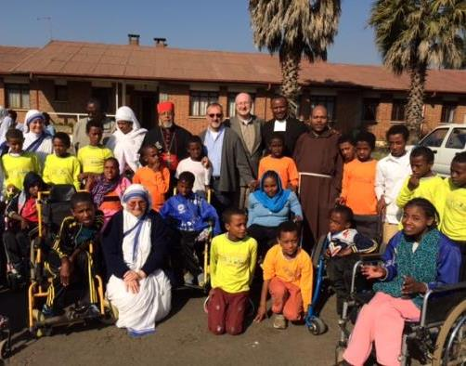







Lasallian Higher Education in Addis Ababa, Ethiopia
Opportunities for Study Abroad, Research, Collaborative Teaching, and Service Learning
May 2016
CRS / Lasallian Exploratory Visit
La Salle University, Philadelphia
Manhattan College
Institute of the Brothers of the Christian Schools
International Association of Lasallian Universities (IALU)
District of Lwanga

Slide 29
An Example of Intersection and Alignment
Manhattan College Strategic Plan 2.5.2
2.5.2 Commit resources to recruit, retain, promote, and support the development of qualified and diverse faculty, staff, and administrators capable of realizing the Lasallian Catholic focus on intellectual contributions and a person- centered education.
With particular emphasis on tenured/tenure-track faculty, in addition to visiting and adjunct faculty.
    DENA Directional Statement (C.3) Living the Charism in Association for Mission
    In order to foster and enrich our Lasallian charism, we recognize the need to invite and encourage all members of Lasallian communities to associate for mission. We aim to ensure that each local ministry is supported by, and in turn, supports district, regional and international formation initiatives.

Slide 30
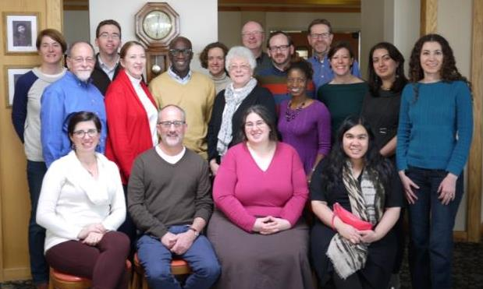
Beyond-Campus
Lasallian Higher Education Colloquy: Together and By Association
January 14-15, 2016
Long Branch, NJ
June 14-16, 2016
Minneapolis, MN
15 Faculty, Staff, and Administrators from Manhattan College
8 from La Salle University, Philadelphia
8 from Saint Mary’s University of MN
Notes:
This past January we gathered with colleagues from La Salle University – and in June with colleagues from Saint Mary’s University of MN – to focus on how our “common core identity” as Lasallian Catholic colleges is brought to life in our contemporary diverse and inclusive setting

Slide 31

Racial Justice: Inclusivity, Diversity and Mission Compatibility
A Lasallian Higher Education Colloquy
January 11-12, 2017
Catholic Higher Education
Catholic Intellectual Tradition and
Catholic Social Teaching
Alignment with Manhattan College Strategic Plan

Slide 32
Funding to Support MC Faculty
January 2017 Travel to
Bethlehem University, Palestine
Project 1233
Strategic Plan 1.1.2, 2.3.1, 3.2.2, 3.4.4
The College seeks to continue to enhance support of faculty in scholarship, teaching and research that is especially, but not exclusively, associated with our Lasallian and Catholic networks.
the Business Analytics Competition,
a Summer Research Project which would include a MC and/or a BU student
work towards a scholarly publication
development of a study abroad course
development of an on-line course

Slide 33


Slide 34


